Slide 1
Queue-Aware Distributive Power and Relay Selection Control for Delay-Sensitive Two-Hop OFDM Cooperative Systems
Vincent Lau
Dept of ECE
Hong Kong University of Science and Technology
Director and Founder
Huawei-HKUST Joint Innovation Lab
May 2010

Slide 2
Outline
Introduction and Motivation
Survey of Existing Approaches
System Model of Two-Hop OFDM Cooperative Systems
Distributive Control Policy
Delay-Optimal Problem Formulation
Sketch of Solution via Stochastic Learning
Convergence Proof and Asymptotic Optimality
Results and Conclusions

Slide 3
Introduction and Motivation
Why delay performance is important?
“WHAT??!! He is stuck in the air!! !$*(&#%*!(!”
You Tube
Fact:
Real-life applications are delay-sensitive

Slide 4
Related Works
Cooperative Systems Joint Power and Relay Selection Design for PHY Performance
[Blet'06],[Mich'08] ,[Beres’08] etc.
Selects the “best ” relays can provide all the benefits of cooperation
Without power allocation
Remark:
Only adapt based on CSIT, ignoring queue states and optimize PHY layer performance only (throughput or PFS)
[Cui’09], [Ng’07], [Li’06] etc.
Joint optimization of relay selection and power allocations
Conclusion: Very important to make use of both (channel state info) CSI and (queue state info) QSI for delay sensitive applications
Notes:
Ying,pls fill in the references.

Slide 5
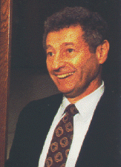
Introduction and Motivations
Challenges to incorporate QSI and CSI in adaptation
Challenge 1: Requires both Information theory (modeling of the PHY dynamics) & Queueing theory (modeling of the delay/buffer dynamics)
Challenge 2: Brute-force approach cannot lead to any viable solution
Information Theory
Queueing Theory
Claude Shannon
Leonard Kleinrock
When Shannon meets Kleinrock…

Slide 6
Existing Approaches to deal with Delay-Optimal Control
Various approaches dealing with delay problems
Approach I : Stability Region and Lyapunov Drift [Berry’02], [Neely’07], etc.
Discuss stability region of point-to-point SISO and multiuser SISO.
Also considered asymptotically delay-optimal control policy based on “Lyapunov Drift”
The authors obtained interesting tradeoff results as well as insight into the structure of the optimal control policy at large delay regime.
Buffer Partitioning
Remark:
This approach allows simple control policy with design insights but the control will be good only for asymptotically large delay regime.
v
-v
S<1/v
S>1/v
Buffer State s
To regulate the buffer state towards 1/v

Slide 7
Related Works
Various approaches dealing with delay problems
Approach II [Yeh’01PhD], [Yeh’03ISIT]
- Symmetric and homogeneous users in single-hop multi-access fading channels
- Using stochastic majorization theory, the authors showed that the longest queue highest possible rate (LQHPR) policy is delay-optimal
A
Capacity region
higher rate for user 1
B
Longer queue for user 1

Slide 8
Related Works
Various approaches dealing with delay problems
Approach III : [Hui’07], [Tang’07], etc.
To convert the delay constraint into average rate constraint using tail probability at large delay regime (large derivation theory) and solve the optimization problem using information theoretical formulation based on the rate constraint.
Remark:
While this approach allows potentially simple solution for single-hop systems, the control policy will be a function of CSIT only and such control will be good only for large delay regime.
Note:
In general, the delay-optimal power and precoder adaptation should be a function of both the CSI and the QSI.

Slide 9
Related Works
Various approaches dealing with delay problems
Approach IV : [Bertsekas’87]
The problem of finding the optimal control policy (to minimize delay) is casted into a Markov Decision Problem (MDP) or a stochastic control problem.
Remark:
Unfortunately, it is well-known that there is no easy solution to MDPs in general.
Brute-force value iteration and policy iteration are very complex and time-consuming.
The curse of dimensionality!!

Slide 10
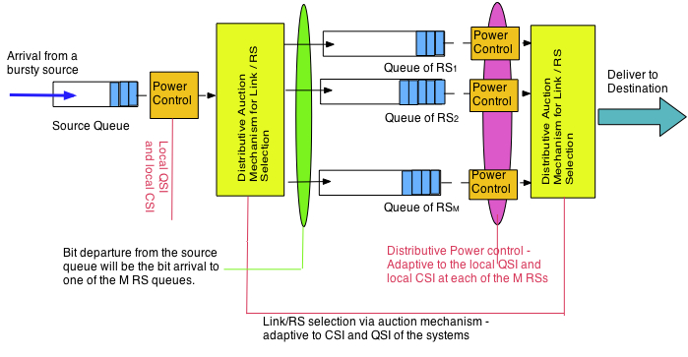
Cooperative System Model
Notes:
Ying, pls update this figure with uplink OFDMA … showing queues at each of the mobiles…etc. [Pls show the queues are scattered locally at each user]

Slide 11
Specific Technical Challenges To be Solved
Challenge 1:
Complex Interactions of Buffers at the Source Node and Relay Nodes.
Challenge 2:
Curse of Dimensionality: Exponential complexity due to coupling among the source node and all the relays.
Challenge 3:
Distributive Implementation:- Control Policy adaptive to Local CSI and Local QSI

Slide 12
Two Hop OFDM Cooperative System Model
Local CSI at m-th RS
Local QSI at m-th RS
RS 1
Subcarrier index
Source
Destination
CSI
CSI
RS M

Slide 13
Queue Dynamics
Time domain partitioned into scheduling slots
CSI H(t) remains quasi-static within a slot and is i.i.d. between slots
Bits arrival I(t), where I(t) i.i.d. according to a general distribution f_{I}(n)
{Q_{s}(t), Q₁(t),…, Q_{M}(t)} denote the backlog in the source node and RS-1,..,RS-M nodes respectively at slot t.
If the source node delivers R_{s,m} bits to the m-th relay at the t-th slot
If the m-th relay delivers R_{m,D} bits to the destination at the t-th slot
Maximum buffer size
Notes:
Ying,pls help me to tidy up the math symbols… e.g. Ak(t)…etc.

Slide 14
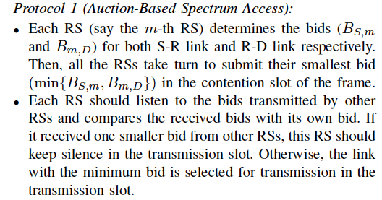
Distributive Control in OFDM Multi-hop Systems
Distributive Power Control:
Power Control at Source Node: (adaptive to local CSI H_{SR,m}(t) and local QSI Q_{S}(t) at the SRC NODE)
Power Control at m-th RS Node: (adaptive to local CSI H_{RD,m}(t) and local QSI Q_{m}(t) at the m-th RS NODE)
Distributive Relay Selection:
Due to the distributive requirement, a contention-based protocol is needed to determine which node (Src, RS-1,..,RS-M) should access the channel at this slot.
A distributive RS selection policy → parameterized by {B_{S,m}, B_{m,D}}
Overall Control Policy
A mapping from the local system state at the m-th RS node to a bidding, power action:
Notes:
Ying,pls help me to tidy up the math symbols… e.g. Ak(t)…etc.

Slide 15
Delay-Optimal Formulation
Definitions: Average Delay, Power and Packet Drop Constraints under a distributive control policy
Denotes expectation w.r.t the underlying measure (induced by )
Little’s Law: average no. of bits = average arrival rate *average delay
the average delay (in terms of seconds) the average queue length
Notes:
Ying, pls modify the problem to include packet dropping constraint + uplink version

Slide 16
Delay-Optimal Formulation
Problem Formulation: Find the optimal control policy that minimizes
Why the Optimization Problem is difficult?
Huge dimension of variables involved
(policy = set of actions over all system state realizations)
K+1 queues are coupled together → Exponentially Large State Space
In general, we cannot have explicit closed-form expression of how the objective function (average delay) is related to the control variables (policy).
The problem is not convex
Key Idea: Divide-and-Conquer
To break a large problem (optimization over the whole policy space)
into smaller sub problems (optimization over a control action at a stage).
Solution: Markov Decision Problem (MDP)
Notes:
Ying, pls modify the problem to include packet dropping constraint + uplink version

Slide 17
Overview of Markov Decision Problem Formulation
Specification of an Infinite Horizon Markov Decision Problem
Decisions are made at points of time – decision epochs
System state and Control Action Space:
At the t-th decision epoch, the system occupies a state
The controller observes the current state and applies an action
Per-stage Reward & Transition Probability
By choosing action the system receives a reward
The system state at the next epoch is determined by a transition probability kernel
Stationary Control Policy:
The set of actions for all system state realizations
The Optimization Problem:
Average Reward
Optimal Policy

Slide 18
Overview of Markov Decision Problem Formulation
Solution of an Markov Decision Problem
Optimal policy (Fixed Point Problem on Functional Space)
Key Criterion: Bellman’s Equation
Under some technical conditions, the optimal value of the problem is given by the solution of the Bellman’s Equation.

Slide 19
Constrained Markov Decision Problem Formulation
CMDP Formulation: Find the optimal control policy that minimizes
LM for Power Constraints
Lagrangian approach to the Constrained MDP:
LM for packet drop constraint
19
Notes:
Pls create a few slides to summarize the main results of the UL OFDMA…. (at most 3 slides)
Followed by a few numerical results to show delay performance, convergence..etc. (3 figures)

Slide 20
Optimal Solution
Infinite Horizon Average Reward MDP
the state space and action space is defined
Given a stationary control policy , the random process evolves like a Markov Chain with transition kernel:
Solution is given by the “Bellman Equation”
“Potential function” (contribution of the state to the average reward)
“Optimal Value”
The state space is extremely huge

Slide 21
Optimal Solution – Online Learning
How to determine the potential function ?
Brute-Force solution of the Bellman Equation ? (Value Iteration):
Too complicated, exponential complexity and memory requirement
Centralized solution will be resulted!!
Online stochastic learning !
Iteratively estimate potential function based on real time observation of CSI and QSI – online value iteration
Distributive Solution:
Per-node Potential and LMs Initialization
Online Policy Improvement Based on Per-stage Bid
Online Per-node Potential and LMs Update [Local CSI, Local QSI]
Termination
Centralized Solution ?
Obtain knowledge of global QSI from the source node and all the relay nodes
Heavy signaling loading to deliver these QSI to all nodes
Must have distributive solution !
Notes:
Ying, fill in details… (summarize the centralized online learning)

Slide 22
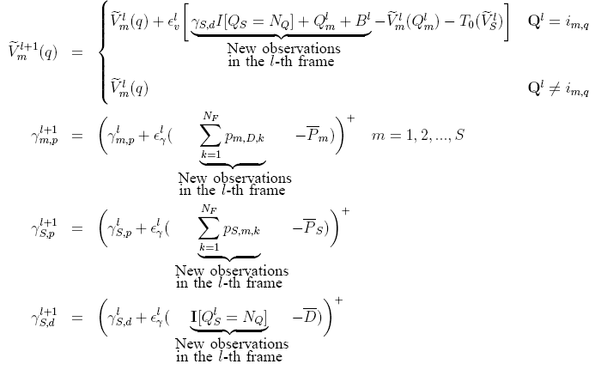
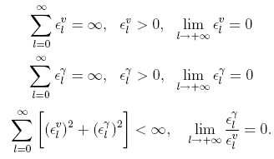
Decentralized Solution (I)
Online Per-node Primal-Dual Potential Learning Algorithm via Stochastic Approximation
Remark (Comparison to the deterministic NUM)
Deterministic NUM: Iterative updates are performed within the CSI coherence time → limit the number of iterations and the performance.
Proposed online algorithm: Iterative updates evolves in the same time scale as the CSI and QSI→ converge to a better solution (no longer limited by the coherence time of CSI).
Both the per-node potential and LMs are updated simultaneously.
Notes:
Ying,pls write an animation to highlight remark 1 (comparison to Deterministic NUM) and simultaneous update of LM and potential.
Also highlight which terms are new observations

Slide 23
Decentralized Solution (II)
Distributive S-R and R-D power and rate allocation
Contention-based link selection:
Each RS takes turns to submit their smallest bid
Water-level depends on QSI (via potential function)
Notes:
Ying, fill in details… (summarize the centralized online learning)

Slide 24
Convergence
Theorem (Convergence of online per-node learning) Under some mild conditions, the distributive learning converges almost surely.
Remark (Comparison to conventional stochastic learning)
Conventional SL: (1) for unconstrained MDP only or LM for CMDP are determined offline by simulation; (2) designed for centralized solution with control action determined entirely from the potential update → Convergence Proof based on standard “contraction Mapping” and Fixed-Point Theorem argument.
Proposed SL: (1) simultaneous update of LM and the potential function; (2) control action is determined by all the users’ potential via per-stage bid→ per-node potential update is NOT a contraction mapping & standard proof does not apply.
Theorem (Asymptotically Global Optimal) For sufficiently large N_{Q} and high traffic loading, the performance of the online distributive per-node primal-dual learning algorithm is asymptotical global optimal. i.e., its performance is the same as the brute-force centralized solution.
Notes:
Write an annimation to point out the remark :(comparison to conventional stochastic learning)

Slide 25
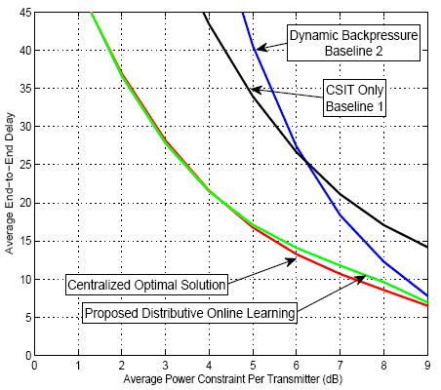
Numerical Results
Average End-to-End Delay vs SNR
Significant gain in delay performance
compared with 2 baselines.
“Dynamic Backpressure” is the queue length weighted throughput maximization.
Close-to-optimal performance
Notes:
Pls also add the convergence

Slide 26
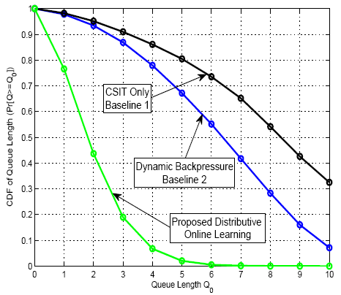
Numerical Results
Cumulative distribution function (cdf) of queue length
The distributive solution has significant gain in delay performance compared with 2 Baselines.
Notes:
Pls also add the convergence

Slide 27
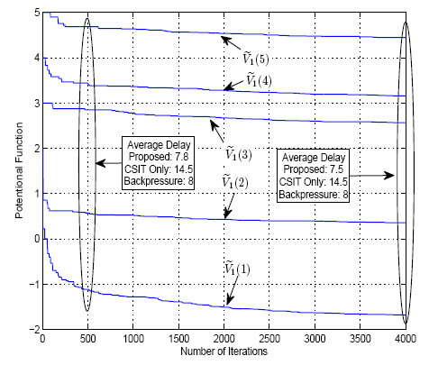
Numerical Results
Illustration of convergence property:
Potential function vs. the scheduling slot index (SNR=9dB)
Notes:
Pls also add the convergence

Slide 28
Conclusion
Distributive Implementation via Decentralized Stochastic Learning
Online Per-node Learning: Simultaneous update of LMs and Potentials. Almost sure convergence
Distributive Control Actions via Per-stage Bid:
Distributive Power and Rate Control: Multi-Level Water-Filling (QSI→ water level; CSI→ allocation)
Link Selection by Per-stage Bid: instantaneous link selection based on (QSI,CSI)
Asymptotically Global Optimal for sufficiently large N_{Q} and high traffic loading

Slide 29
Thank you! Questions are Welcomed!
eeknlau@ee.ust.hk
http://www.ee.ust.hk/~eeknlau

