Slide 1
Delay-Optimal Precoder Adaptation for Multi-stream MIMO Systems in Wireless Fading Channels
Vincent Lau
Dept of ECE
Hong Kong University of Science and Technology

Slide 2
Outline
Introduction
System Model
Markov Decision Problem Formulation and Challenges
Multi-Level Water-Filling Solution
Numerical Results
Conclusion

Slide 3
Outline
Introduction
  Why Delay is Important
  Using MIMO to Boost PHY Layer Performance
  The Scenario of Multi-stream MIMO Link
  Related Works & Remaining Challenges
System Model
Markov Decision Problem Formulation and Challenges
Multi-Level Water-Filling Solution
Numerical Results
Conclusion

Slide 4
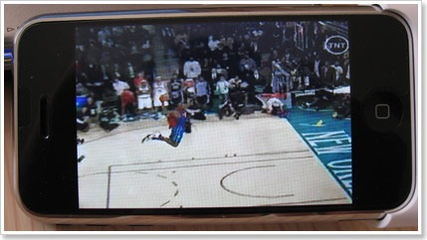
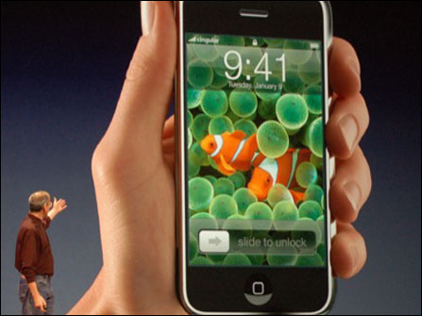
Introduction
Why delay performance is important?
“WHAT??!! He is stuck in the air?? !$*&(#@&@#!!”
“You must be kidding me! Buffering at such an important moment!!??”
You Tube
Conclusion I:
Real-life applications are delay-sensitive!!

Slide 5
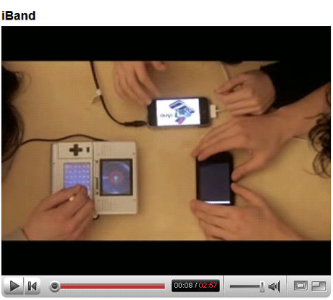

Introduction
We may have multiple delay-sensitive wireless applications running at the same time!
Play multi-player game
Keep track of a game
Conclusion II:
Different applications have heterogeneous delay-requirement
Keep talking to some friends

Slide 6




Introduction
MIMO is well-known to boost the PHY Performance
Wireless Fading Channel
SISO
MIMO
Encoder
MIMO
Decoder
Spatial Multiplexing Gain
Diversity Gain
Wireless Fading Channel
MIMO

Slide 7


Introduction
Using MIMO to Boost PHY Layer Performance
S/P
STBC/SM
MIMO
Detector
Wireless Fading Channel
Q) How is this related to Delay? Can’t we just use conventional technique in MIMO to boost the PHY performance? If the PHY is improved, the delay of the application will be improved as well.
NO CSIT
S/P
MIMO Precoder
&
Power
Control
Wireless Fading Channel
MIMO
Detector
Perfect CSIT

Slide 8

Introduction
Multi-stream MIMO Link
Delay REQ 1
Fring
Packets
MIMO Precoder
&
Power
Adaptor
Wireless Fading Channel
G-MAP
Packets
Delay REQ 2
YouTube
Packets
Delay REQ L
Queueing State Information (QSI)
Channel State Information (CSI)

Slide 9
Related Works
Traditional MIMO precoder design for PHY
[Sampath’01], [Scaglione’99],[Palomar’03], etc.
Linear MIMO precoder design framework to minimize the weighted sum of mean square errors (MSE) assuming knowledge of perfect CSIT.
In general, optimal precoder may not always diagonalize the channel
Remark:
Only adapt based on CSIT only, ignoring queue states and optimize PHY layer only metric
[Love’05], [Lau’04], [Rey’05], [Palomar’04], etc.
MIMO precoder design with limited feedback.
MIMO adaptation design with outdated CSIT.
[Kittipiyakul’04] : naive water-filling, which is optimal in information theoretical sense, is not always a good strategy w.r.t. the delay performance.
Conclusion: Very important to make use of both (channel state info) CSI and (queue state info) QSI for delay sensitive applications

Slide 10
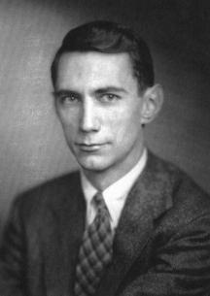
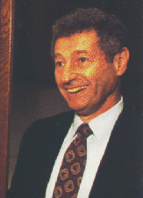
Introduction
Challenges to incorporate QSI and CSI in adaptation
  Challenge 1: Requires both the Information theory (modeling of the PHY dynamics) & the Queueing theory (modeling of the delay/buffer dynamics)
  Challenge 2: Brute-force approach cannot lead to any viable solution
Information Theory
Queueing Theory
Claude Shannon
Leonard Kleinrock
When Shannon meets Kleinrock…

Slide 11
Related Works
Various approaches dealing with delay problems
Approach I : Stability Region and Lynapnov Drift [Berry’02], [Neely’07], etc.
Discuss stability region of point-to-point SISO and multiuser SISO.
Also considered asymptotically delay-optimal control policy based on “Lynapnov Drift”
The authors obtained interesting tradeoff results as well as insight into the structure of the optimal control policy at large delay regime.
Remark:
This approach allows simple control policy with design insights but the control will be good only for asymptotically large delay regime.
v
-v
S<1/v
S>1/v
Buffer State s
To regulate the buffer state towards 1/v

Slide 12
Related Works
Various approaches dealing with delay problems
Approach II [Yeh’01], [Yeh’03]
- Symmetric and homogeneous users in multi-access fading channels
- Using stochastic majorization theory, the authors showed that the longest queue highest possible rate (LQHPR) policy is delay-optimal
A
Capacity region
higher rate for user 1
B
Longer queue for user 1

Slide 13
Related Works
Various approaches dealing with delay problems
Approach III : [Wu’03], [Hui’07], [Tang’07], etc.
To convert the delay constraint into average rate constraint using tail probability at large delay regime and solve the optimization problem using information theoretical formulation based on the rate constraint.
Remark:
While this approach allows potentially simple solution, the control policy will be a function of CSIT only and such control will be good only for large delay regime.
Note:
In general, the delay-optimal power and precoder adaptation should be a function of both the CSI and the QSI.

Slide 14
Related Works
Various approaches dealing with delay problems
Approach IV : [Bertsekas’87]
The problem of finding the optimal control policy (to minimize delay) is cast into a Markov Decision Problem (MDP) or a stochastic control problem.
Remark:
Unfortunately, it is well-known that there is no easy solution to MDP in general.
Brute-force value iteration and policy iteration are very complex and time-consuming.
In addition, it is usually very complex to evaluate the optimal solution even numerically.

Slide 15
Related Works
Technical Challenges to be Solved
Challenge 1:
Low complexity optimal control policy for delay sensitive resource allocation problem in general delay regime.
Remark 1:
Most of the existing works considered large delay asymptotic solutions.
However, practical operating region for delay sensitive traffics are usually on the low delay regime and hence the asymptotic simplifications cannot be applied.
Therefore, it is important to obtain low complexity control policy for general delay regime.
Brute force optimization is challenging because (a) the problem is not convex; (b) huge dimension of variables involved; (c) Not able to express the average delay in terms of the control variables.

Slide 16
Related Works
Remaining Challenges to be Solved
Challenge 2:
Coupling among multiple delay-sensitive heterogeneous data streams.
Remark 2:
Most of the above works considered single stream wireless link only.
While [Yeh’01], [Yeh’03] considered multi-access systems, the framework applies to situations with homogeneous users only and cannot be extended to situations with heterogeneous users.
When we have heterogeneous data streams, the problem will be difficult as the optimal policy will generally be coupled with the joint queue state of all the heterogeneous streams.
And the general solution involves solving multi-dimensional MDP with exponential order of complexity w.r.t. the number of streams.

Slide 17
Related Works
Remaining Challenges to be Solved
Challenge 3:
Delay-sensitive MIMO precoder design with outdated CSIT.
Remark 3:
In practice, CSIT is not perfect.
There will be spatial interference between the MIMO channels.
The MIMO precoder design for delay-sensitive applications will be difficult because the resulting SINR of the spatial channels are coupled together with different delay requirements among the spatial streams.

Slide 18
Outline
Introduction
System Model
  MIMO Physical Layer Model
  Queue Model & System States
  Objective & Control Policy
Markov Decision Problem Formulation
Low Complexity Solution
Numerical Results
Conclusion

Slide 19
System Model
Multi-Stream MIMO Physical Layer Model
Imperfect CSI
Linear Precoder
Linear Equalizer

Slide 20
System Model
Imperfect CSIT
Imperfect CSIT in FDD System:
CSIT is obtained by explicit feedback.
CSIT is imperfect due to the limited feedback bits constraint
Imperfect CSTI in TDD System:
CSIT is obtained by implicit feedback using the channel reciprocal property between the forward and reverse link.
CSIT is imperfect due to estimation noise and the duplexing delay.
-- reverse link pilot SNR
Perfect CSIT :
No CSIT :

Slide 21
System Model
MIMO Physical Layer Model
Wiener filter
Simultaneously maximize
Equivalent channel (P, H, W) for the L data stream:
Conditional average SINR of the i-th data stream:
MIMO PHY Layer
Precoder P
Conditional symbol error probability for QAM constellation:
Data rate (bits per symbol) of the i-th data stream:

Slide 22
System Model
Queue Dynamics & System States
G-MAP
Packets
QSI
MAC State
YouTube
Packets
MIMO Precoding Control Action
Cross Layer
MIMO Precoding Controller
MAC Layer
CSI
MIMO
Precoder
PHY Layer
PHY State
Packet Arrivals
time
PHY Frames
Channel is quasi-static in a slot
i.i.d between slots

Slide 23
System Model
the service rate of the L streams are coupled together because of the precoder P
Objective & Control Policy
M/M/1 Queue
System parameters:
Poisson arrival with rate:
Average packet length:
(exponentially dist.)
Challenges:
Huge dimension of variables involved
Exponential State Space
No closed form expression for average delay (in terms of precoder)
Based on P
Definitions:
Average delay of the i-th stream:
Average power constraint:
Positive weighting factors
(Pareto Optimal Tradeoff)
Lagrange multiplier for the average power constraint
Optimization problem: Delay Optimal Policy

Slide 24
Outline
Introduction
System Model
Markov Decision Problem Formulation and Challenges
  Embedded Markov Chain & MDP Formulation
  Bellman Condition & Optimal Precoding Structure
  Optimal Power Allocation Policy
  Summary of the Optimal Solution
Multi-level Water-filling Solution
Numerical Results
Conclusion

Slide 25
Markov Decision Problem Formulation
Overview of MDP (Stochastic Dynamic Programming)
Key Idea: Divide-and-Conquer
To break a large problem (optimization over the policy space) into smaller problem (optimization over a control action at a stage).

Slide 26

Markov Decision Problem Formulation
Specification of an Infinite Horizon Markov Decision Problem
  Decisions are made at points of time – decision epochs
  System state and Control Action Space:
    At the t-th decision epoch, the system occupies a state
    The controller observes the current state and applies an action
  Per-stage Reward & Transition Probability
    By choosing action the system receives a reward
    The system state at the next epoch is determined by a transition probability kernel
  Stationary Control Policy:
    The set of actions for all system state realizations
  The Optimization Problem:
    Average Reward
    Optimal Policy

Slide 27
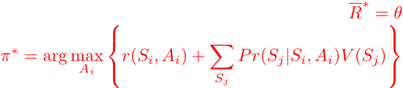
Markov Decision Problem Formulation
Solution of an Markov Decision Problem
Key Criterion: Bellman’s Equation
Under some technical conditions, the optimal value of the problem is given by the solution of the Bellman’s Equation.

Slide 28
Markov Decision Problem Formulation
Infinite Horizon MDP Structure of our Precoder Problem
Our Decision Epoch: Time slots
Our System State at the m-th slot:
Our Control action at the m-th slot: Precoder
Our Per stage “reward”:
Our Average “reward” (average delay):
decision epoch
decision epoch
time
System state
action
Control policy
L-stream MIMO system
reward

Slide 29
Markov Decision Problem Formulation
Our Transition Probability Kernel:
For a given control policy ,the sequence of joint queue state observed at each time slot is an L-dim controlled Markov Chain.
Due to the different time scales on slot duration and packet arrival / departure process, at the -th decision epoch, only one of the following events can happen:
Event 1:
Packet arrival from the i-th data source
Poisson arrival assumption for all streams
Event 2:
Packet arrival from the i-th data source
Poisson arrival assumption for all streams
Event 3:
Nothing happens
Notes:
Define the embedded markov chain from Q(t) and Point out the birth death dynamics and the associated transition probabilty, draw the transition diagram of the QSI transition probability.
Write down the global state transition probability (including CSI and QSI), our per-stage reward, our action .. (associate the general MDP components in the previous page → our specific situation)
The above MDP formulation is complicated due to continuous state space (CSI) → package into a lemma that the problem is equivalent to a reduced state MDP. (MDP in terms of QSI transition only)…

Slide 30
Markov Decision Problem Formulation
Our Transition Probability Kernel:
State transition diagram for L-dimension Markov chain {Qm} with N states each dimension. L=2 for illustration.
The induced Markov Chain is “aperiodic” and “irreducible”.
Notes:
Define the embedded markov chain from Q(t) and Point out the birth death dynamics and the associated transition probabilty, draw the transition diagram of the QSI transition probability.
Write down the global state transition probability (including CSI and QSI), our per-stage reward, our action .. (associate the general MDP components in the previous page → our specific situation)
The above MDP formulation is complicated due to continuous state space (CSI) → package into a lemma that the problem is equivalent to a reduced state MDP. (MDP in terms of QSI transition only)…

Slide 31
Delay-Optimal MIMO Precoding Solution
Two Major Challenges
  1) continuous state space (CSI):
    Most of the results in MDP theory applies to countable state space only. Extension to continuous state space is not trivial.
  2) Exponentially large Q state (QSI):
    The total number of states in the joint-queue-state (QSI) = N^L
    Exponentially large → complexity and memory requirement = O(exp[L])!!

Slide 32
Challenge (I) – Reduced State MDP
Solution 1) Reduced State MDP
  One challenge of the MDP problem is the continuous state space (CSI).
  Most of MDP solutions require finite state space.
  Observe that given a control policy , the induced markov chain {Q(m)} only depends on the control via the “conditional average service rate”
We could have an equivalent “reduced state MDP” (evolves based on the finite state space Q)

Slide 33
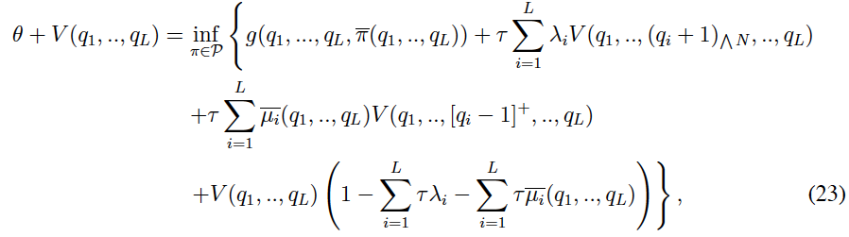
Challenge (I) – Reduced State MDP
Bellman Condition & Optimal Precoding Structure
    Optimal solution is obtained by the Bellman’s equation

Slide 34
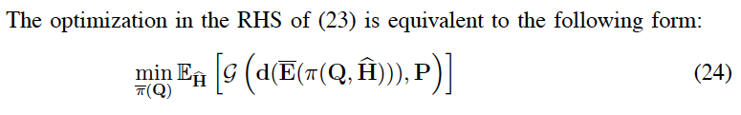
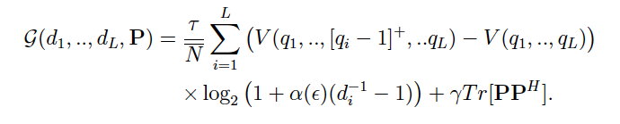
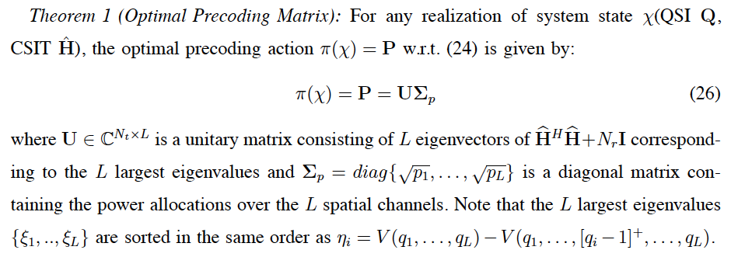
Challenge (I) – Reduced State MDP
Optimal Precoding Structure
Delay Optimal Precoder still has a “MIMO channel Diagonaling Structure”

Slide 35



Challenge (I) – Reduced State MDP
Remaining Problem is to solve for power allocation across the L streams
Optimal power allocation policy
  “Multi-level” water-filling type solution
    “Water-filling” based on the CSI
    “Water level” depends on the QSI (indirectly via

Slide 36
Challenge (I) – Reduced State MDP
How to obtain the “water-level” ?
    Solving the Bellman Equation (23) ~
    Exponential complexity and memory requirement w.r.t L (# of data streams) → Not a scalable solution

Slide 37
Challenge (II) – Decomposition of MDP
The coupling of the L-dimension MDP is due to the “dynamic sorting of eigenvalues” according to
  Associate the largest eigenchannel to the stream with the largest .
To reduce the complexity of the solution, we restrict to “static sorting” of eigenvalues.
  Associate the largest eigenchannel to the stream with the largest and so on…
Lemma 3: (Additive Property): Based on “static sorting” policy, the solution to the Bellman’s equation has the form

Slide 38
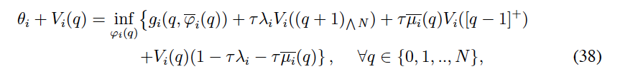


Challenge (II) – Decomposition of MDP
As a result, the Bellman’s equation can be decomposed into L 1-D Bellman’s equation:
Exploiting the Birth-Death Queue Dynamics, the 1-D Bellman’s equation can be solved recursively (easily):

Slide 39
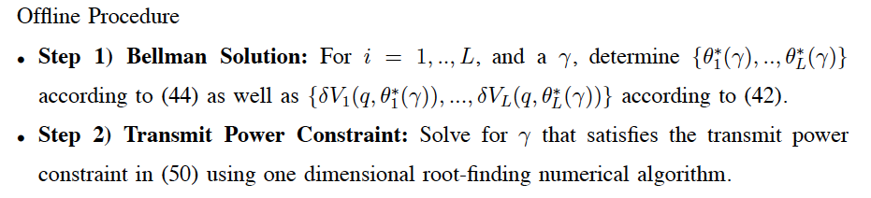


Low Complexity Solution – Offline Solution
  Offline Solution ~ Complexity O(L)
Outputs of the Offline Procedure

Slide 40
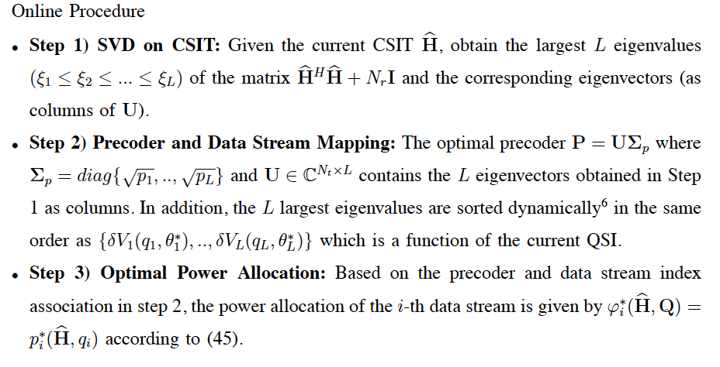

Low Complexity Solution – Online Procedure
Instantaneous CSI
& QSI of L-streams
Memory storing results
of Offline Solution (O[L])
MIMO Precoder &
Power Allocation

Slide 41
Outline
Introduction
System Model
Markov Decision Problem Formulation
Low Complexity Solution
Numerical Results
  Optimal Solution v.s. Low Complexity Solution
  Different Antenna Configurations
  Impact of the CSIT Error Variance
  Conclusion

Slide 42
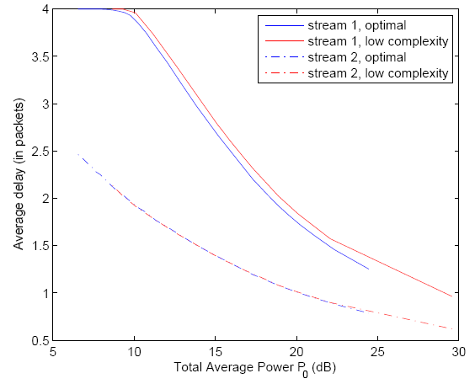
Numerical Results
How much performance loss if using the low complexity solution?
Condition:
No. of data streams : 2
Buffer length : 4
Arrival rate : 0.02 p/ch use
Frame Duration: 5 ms
Target SER : 0.01
Weighting factors : 1 / 10
Average packet size: 200 bits
Remark:
Support heterogeneous delay application
“static sorting” achieves near optimal performance.

Slide 43
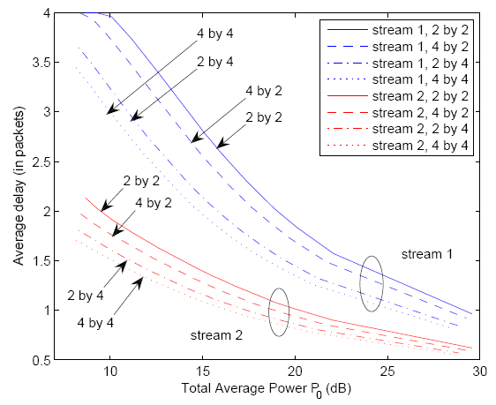
Numerical Results
How is the low complexity performance under different antenna configuration?
Condition:
No. of data streams : 2
Buffer length : 4
Arrival rate : 0.02 p/ch use
Frame duration: 5 ms
Target SER : 0.01
Weighting factors : 1 / 10
Average packet size: 200 bits
Remark:
Delay comparison w. r. t. MIMO configuration

Slide 44
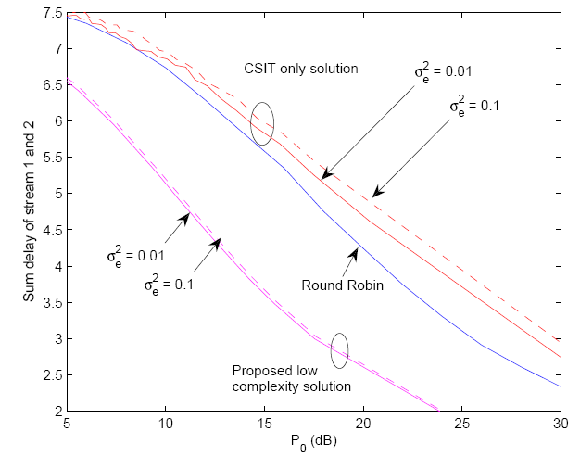
Numerical Results
How is the low complexity performance compared with different baselines?
Condition:
No. of data streams : 2
Buffer length : 4
Arrival rate : 0.02 p/ch use
Frame Duration: 5 ms
Target SER : 0.01
Weighting factors : 1 / 10
Average packet size: 200 bits
gain
Remark:
Better performance than the two baselines:
  Round-Robin
  Traditional MIMO precoding (CSIT only)
Robust to CSIT errors

Slide 45
Outline
Introduction
System Model
Markov Decision Problem Formulation
Low Complexity Solution
Numerical Results
  Conclusion

Slide 46
Conclusion
Conclusion 1:
Delay-Optimal MIMO Precoder – a function of both CSI and QSI with channel diagonalizing structure.
Conclusion 2:
Delay-Optimal Power Allocation – multilevel water-filling: Water-filling across CSI, water level determined by QSI.
Conclusion 3:
Proposed a “reduced state MDP” to deal with the continuous state space challenge
Conclusion 4:
Proposed a “static-sorting scheme” to decompose MDP → low complexity algorithm O(L) to obtain “water-levels”.

Slide 47
Thank you!
Questions are Welcomed!
Vincent Lau – eeknlau@ust.hk

